Slide 1
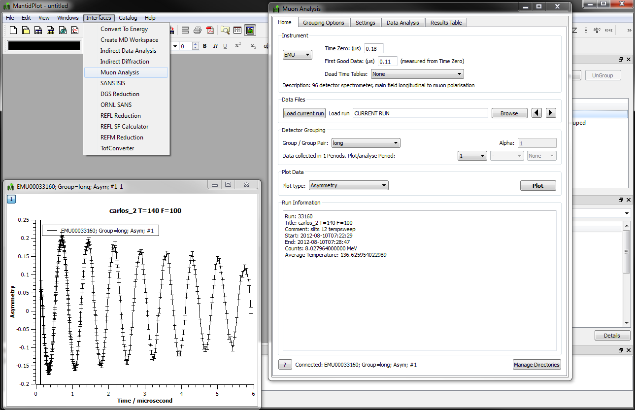
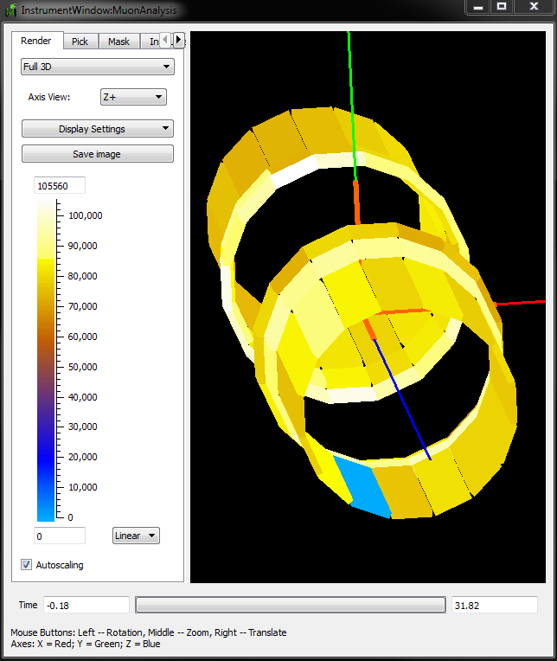
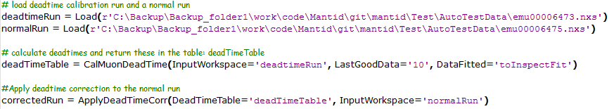
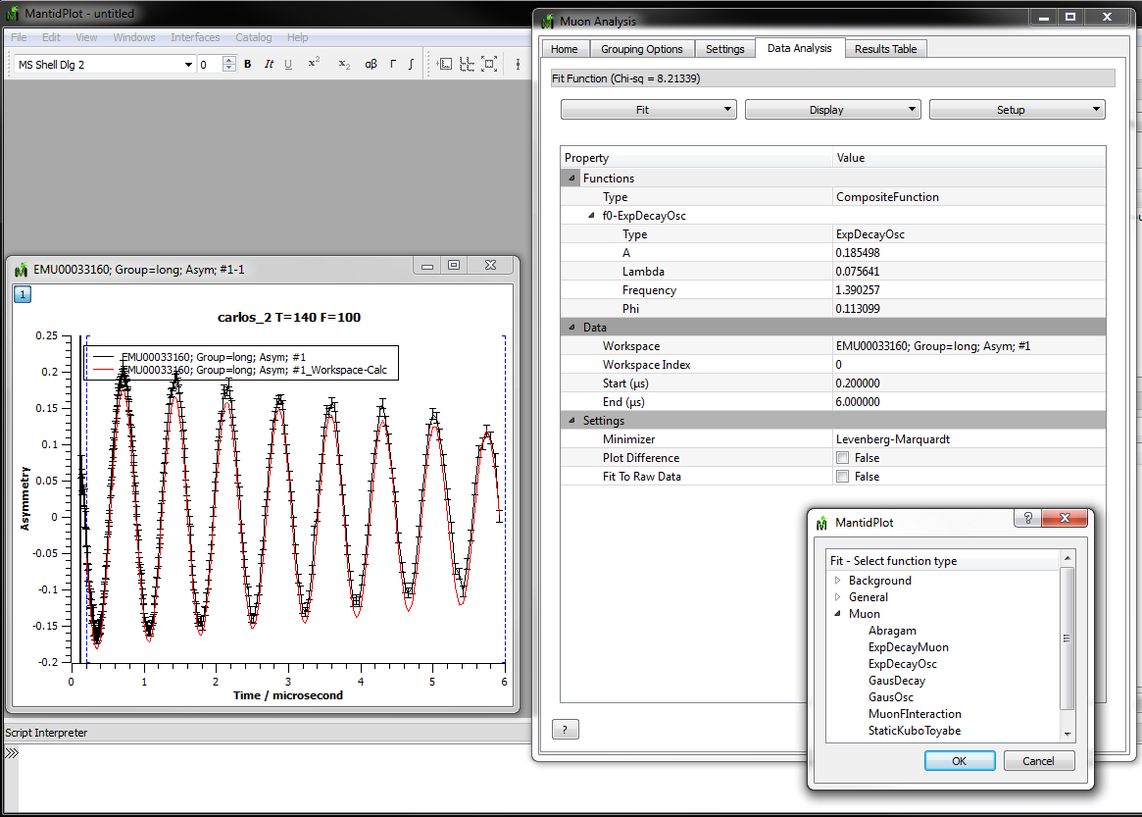
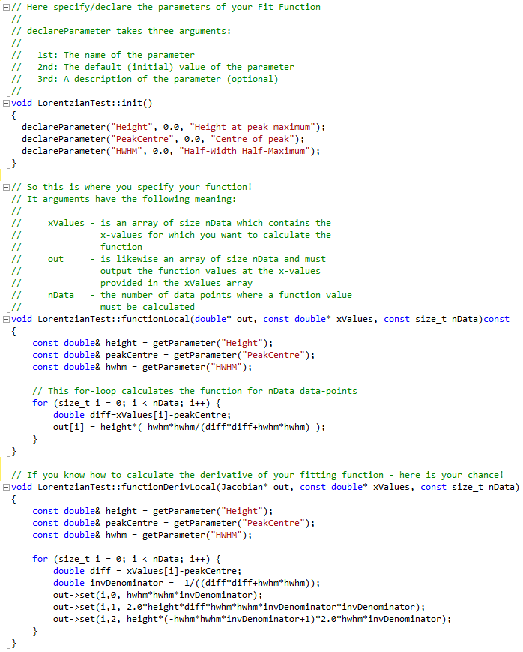
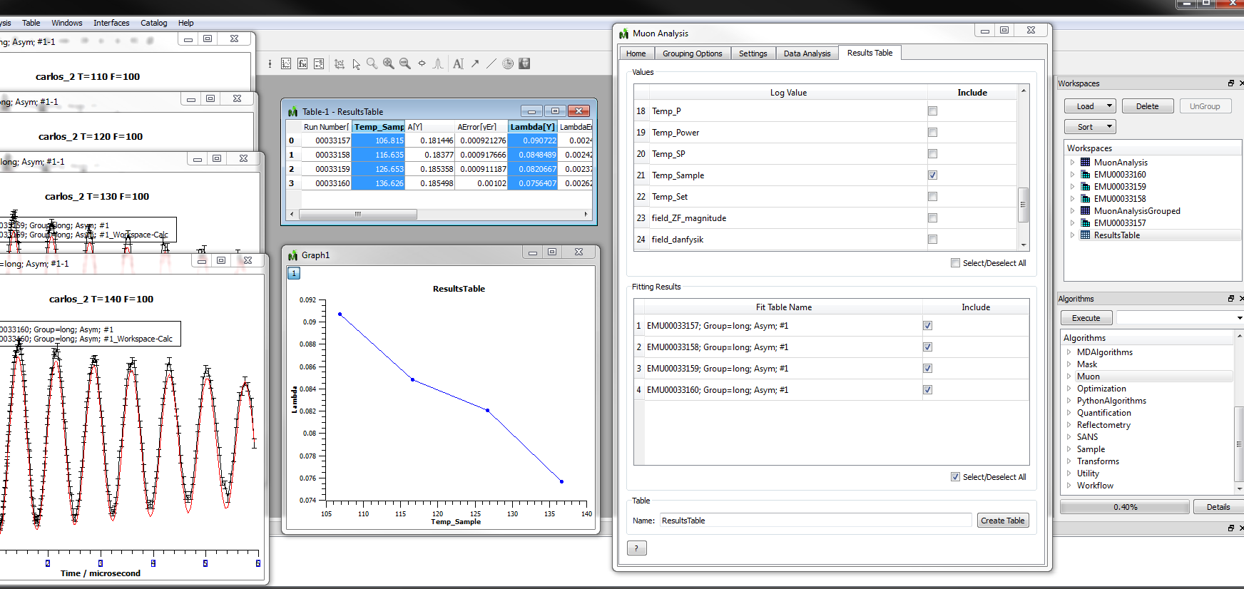



Mantid as a tool for μSR analysis
Anders Markvardsen¹, Robert Whitley¹, Stephen Cottrell¹, Francis Pratt¹, Adrian Hillier¹, Philip King¹, Freddie Akeroyd¹, Nick Draper², Yuan Yao³
¹STFC – Rutherford Appleton Laboratory, Chilton, Didcot, Oxfordshire,OX11 0QX, UK ²Tessella plc, 26 The Quadrant, Abingdon, Oxfordshire, OX14 3YS, UK ³Department of Physics, Clarendon Laboratory, Parks Road, Oxford, Oxfordshire, OX1 3PU, UK
Introduction The development of Mantid (www.mantidproject.org) [see also the other Mantid posters] offers the muon community access to an analysis framework that is attracting broad international support, with both ISIS and the SNS committed to using it as the primary means of data analysis. The Mantid project provides an open source cross-platform framework of core routines and visualisation tools on which the various scientific communities can build analysis software specific to their needs. Here, we report on a successful development of μSR analysis tools for the ISIS muon group, to analyse data collected on the instruments EMU, ARGUS, MuSR and HIFI. Scripting All Mantid interfaces, including the Muon interface, work by making calls to Mantid algorithms that are designed and coded to perform specific tasks. Hence, behind the scenes, all that is happening when using an interface is that a sequence of algorithms are executed by the Mantid Framework. Any such sequence can alternatively be executed using a script, since the Mantid framework is exposed through a Python API. The scripting interface enables advanced users to carry out automated data reduction and to build customised analysis scripts for specialised experiments. Below is shown an example where two datasets are loaded and one of these are corrected for deadtimes. Adding Fitting Functions An essential part of muon analysis involves fitting of data. Mantid ships with a fitting module that contain a number of fit minimisers and a plugin architecture that makes it is easy for a user to add their own fitting functions. In words all that a user needs to do to add a fit function is to know the mathematical expression of the fit function and the names of its parameters. To increase speed the user can optionally provide the mathematical expression for the function derivatives. If this is not provided numerical derivatives are used for the minimisers which are relevant. In code below is shown what is takes to add a fit function (here Lorentzian fit function) At an early stage of this project, a student, not otherwise familiar with the Mantid code, was able to create the first set of Muon fitting functions. This library of functions was further tested by members of the muon group, and then added to the Mantid code base together with unit tests. | The User Interface The Muon user interface is the gateway to Mantid analysis on the Muon beamlines. As shown below it is launched from within MantidPlot, and once launched many important muon data analysis tasks can be performed entirely from within this interface. Important tasks allowed by the user interface:
Optionally visualise data in the instrument view. This view shows a 3D view of the instrument, which, for example, can be used to visually spot if a detector is faulty
Launch MuonAnalysis interface and visualise data
Launch interface
After visualising data, it is time to extract information from
the data by fitting data against muon fitting functions
Quick visualisations of data, either current data or past data; using information in the data files and info from the settings tab to ensure that the most useful view of muon data gets displayed
Optionally have the data corrected for deadtimes before they are displayed
Change how spectra are grouped and form pairs
Plot various muon specific types of plots used for visually inspect data
Fit data to muon model functions
Analyse results from fits to several datasets
Function
used for
fit
Available
fitting
functions
Analyse results from fits to several datasets
Workspaces
created
during
analysis
Plot fit parameter, Lambda,
as a function of log value,
Temp_Sample
Algorithms
library
Acknowledgements: Martyn Gigg, Roman Tolchenov and Karl Palmen
For documentation on the Mantid Muon interface see www.mantidproject.org/MuonAnalysis.
Some of the work presented here was also recently reported in S. Cottrell et al., Physics Procedia 30, 20-25 (2012).

